Slide 1









My Algebra – Polynomials Interactive Notebook
$$×$$
$$\frac{1}{2}$$
$$÷$$
$$+$$
$$−$$
$$\frac{3}{5}$$
$$7$$
Name
Class
Teacher
Term 2 Semester 1
$$5^{2}$$
$$\sqrt{9}$$

Slide 2
Contents
Glossary or Formula Page
Page
Date
Description
2

Slide 3
Tasks
24
7
30
Essential Question
Questions
Notes
Summary
6

Slide 4
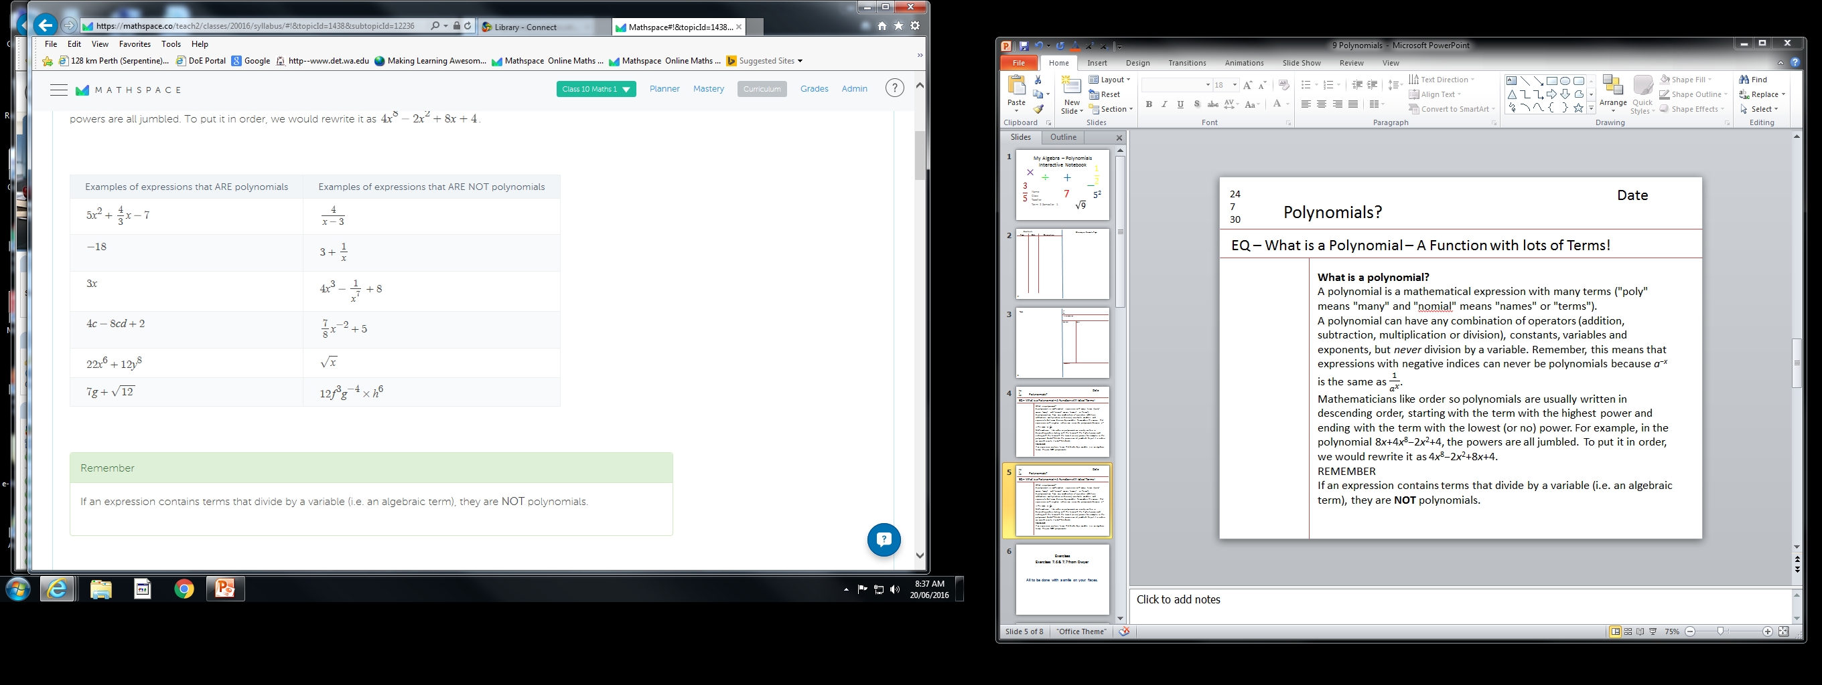
24
7
30
Date
Polynomials?
EQ – Multiplying – How do we Multiply two Polynomials !
Multiplying Lots of Terms
In this section, we are going to look at how to multiply polynomials. The good news is that we've already started to do this without even knowing it when we learnt how to expand binomials using the distributive law! Remember,
Not all questions are the same as binomial expansion though. We may be asked to evaluate the product of two polynomials.
For example, if P(x)=12 and Q(x)=9, the product of these polynomials is 12×9, which equals 108.
ie. P(x)Q(x) = 108.
REMEMBER
Every term in one pair of brackets has to be multiplied by every other term in all the other pairs of brackets.

Slide 5
24
7
30
Date
Polynomials?
EQ – Multiplying – How do we Multiply two Polynomials !
Example 1: Expand (a+2)(5a²−2a+2)
= a(5a²−2a+2) + 2(5a²−2a+2)
= a*5a² - a*2a + a*2 + 2*5a² – 2*2a + 2*2
= 5a³ - 2a² + 2a + 10a² - 4a + 4
= 5a³ + 8a² -2a + 4
Multiply the a and the 2 into the other bracket
Add/subtract like terms

Slide 6
24
7
30
Date
Polynomials?
EQ – Multiplying – How do we Multiply two Polynomials !
Example 1: Expand (-3x²+2)(4x³ - 7x² −2x+8)
= -3x² (4x³ - 7x² −2x+8) + 2(4x³ - 7x² −2x+8)
= (-3x² )*4x³ - (-3x² )*(7x²) -(-3x² )*(2x) +(-3x² )*8 + 2*4x³ -2*(7x²) – 2*(2x) + 2*8
= -12x⁵ + 21x⁴ + 6x³ – 24x² + 8x³ – 14x² – 4x + 16
= -12x⁵ + 21x⁴ + 14x³ – 38x² – 4x + 16
Multiply the -3x² and the 2 into the other bracket
Add/subtract like terms

Slide 7
Exercises
Exercise 9.4 from Dwyer
Also by solve by Long Division
1. 350 ÷14 2. 3542 ÷14
3. 2852 ÷ 23 4. 3696 ÷16
Also have a look at Ex 9.5
All to be done with a smile on your faces.

Slide 8
Notes Review
24, 7 ,30
Date
Title
Essential question
Notes complete
Notes complete with colour and diagrams
Questions completed
Contents page filed in
Formula page filled in

Slide 9
Homework
Review your notes and write a summary answering the essential question.

